Slide 1

Capstone project Facial Emotion detection – deep learning
Notes:
1

Slide 2




Background
Facial expressions plays a significant role
55% of emotional exchanges occur through facial expressions
Communicate and understand emotions
Facial emotion detect helps create more emotionally intelligent machines
Improve human-machine interactions in a variety of settings
Create a deep learning model that can classify multiple classes of facial expressions
Happy, Sad, Neutral, Surprise
Notes:
Before we start, I want to give you some background information on facial emotion detection.
Facial expressions are an important aspect of human communication and play a significant role in express emotions.
Research has shown that up to 55% of emotional exchanges through facial expressions.
So that, the ability to recognize facial expressions is crucial for effective communication and understanding of emotions.
In our project, we will create a deep learning model that can classify multiple classes of facial expressions, such as happy, sad, neutral and surprise.
We can help create more emotionally intelligent machines and improve human-machine interactions in a variety of settings.

Slide 3

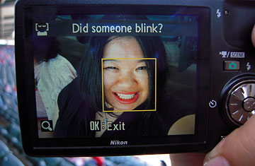
Background
Application are mostly used in
Healthcare
Education
Marketing
Entertainment
Notes:
Nowadays, the development of facial emotion detection technology has many potential applications.
Including in healthcare, education, marketing and entertainment.
For example, monitor and diagnose emotional disorders, such as depression and anxiety.
Improve the emotional engagement of students in online learning environments
On the mobile device / camera, smile detection.
These are the application of the facial emotion detection.

Slide 4
Introduction
The most effective algorithms and techniques for recognizing and classifying emotions
Address bias and fairness in facial emotion detection
Improve the accuracy and performance of facial emotion detection system
Notes:
In this project, we are going to find out the most effective algorithms and techniques for recognizing and classifying emotions.
Also we will address bias and fairness concerns and improve the accuracy and performance of facial emotion detection system

Slide 5


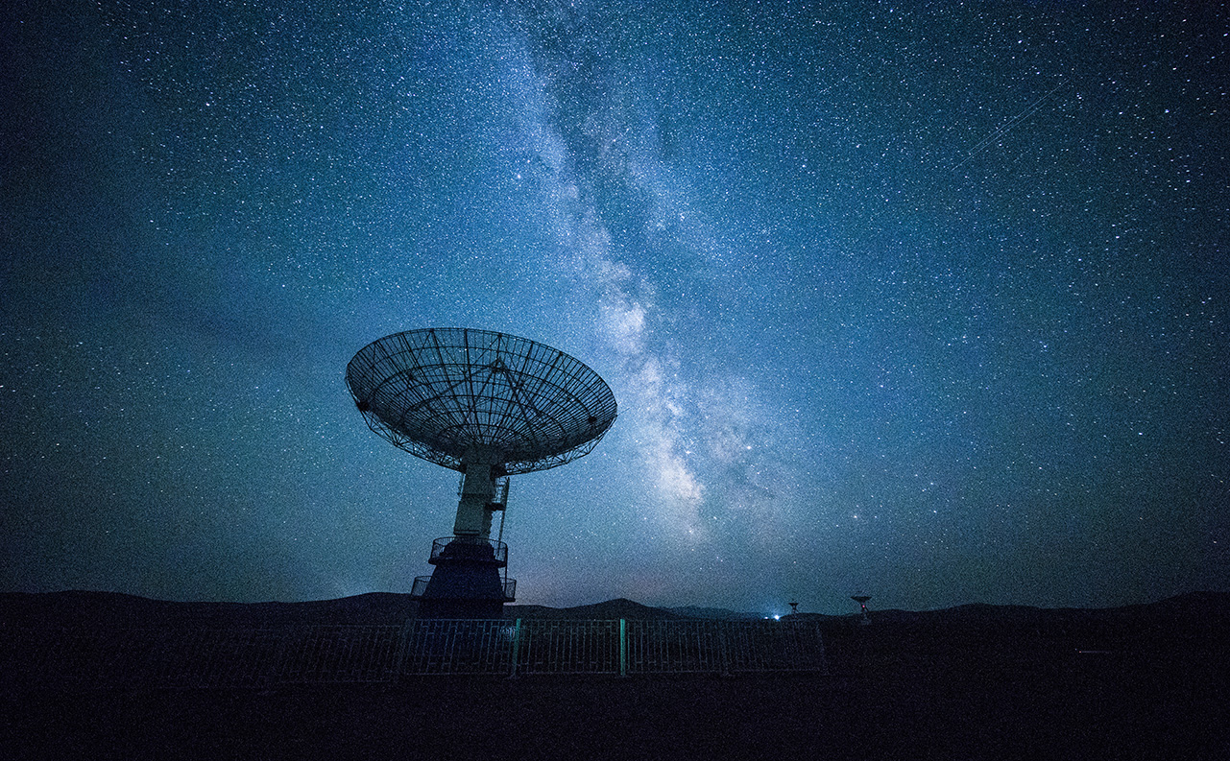
Solution approach
Data Exploration
Build Model
And Evaluate
Final Model Solution
Notes:
Before we design the model, we need to do data exploration to analysing and visualizing data to understand about its characteristic, distributions and relationships.
It i an important step helps identify patterns, outliers, and potential issues with the data.
By using data exploration can gain a better understanding of the data and its characteristics, and make more informed decisions about data modelling and analysis.
Than we will try to build a model and evaluate model performance. After tuning the model, we will make a final decision for the model solution
5

Slide 6
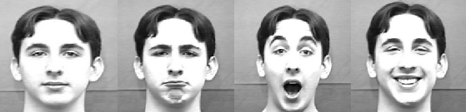
Data Exploration
Key patterns of the facial expressions
Mouthing, Eyebrows, Cheek
Data distribution
Affect the performance of the model
EDA
Image statistics
Notes:
First step is data exploration:
We can observe common patterns of facial expressions include:
Mouthing – movements of the lips and mouth, such as opening, closing, smiling
Eyebrows – movements of the eyebrows, such as raising, lowering, or furrowing
Cheek – movements of the cheeks, such as dimpling, puffing, or wrinkling
For example:
The patterns of happy: the corners of the mouth are turn up and upper teeth may slightly visible. Cheek raised and wrinkles around the cheek, also the eyebrows slightly raised
The patterns of sad: Furrowed eyebrows, they are often pulled down. The eyelids may be drooping and lowered, the corners of the mouth are turned down, sometimes may be loss of symmetry between the left and right sides of the face
The patterns of neutral: the face is generally symmetrical, relaxed facial muscles, no particular tension or activity. The mouth is closed.
The patterns of surprise: raised eyebrows and pulled up towards the hairline. The eyes are widened with the whites of the eyes more visible. The mouth is slightly opened, create a more round or ovel shape.
6

Slide 7
Data Exploration
Key patterns of the facial expressions
Mouthing, Eyebrows, Cheek
Data distribution
Affect the performance of the model
EDA
Image statistics
Notes:
Understanding the distribution of facial expressions in the data is important for developing accurate and effective facial emotion detection models.
If the data is unbalanced or biased towards certain emotions, it will affect the model result.
From the above pie chat, we can find that the proportional of surprised class in training and validation dataset is less than other.
And the testing data distribution equality
Data augmentation and class weighting when training can help with dataset unbalance problem.
Data augmentation is a technique that generating new training data by applying transformations, such as rotations, flips, zoom, etc. To the existing data. This can help increase the diversity of the training data and improve the robustness.
Class weighting helps the model learn to better distinguish between the different classes due to you can try using class weights to give more importance to the underrepresented classes.
7

Slide 8
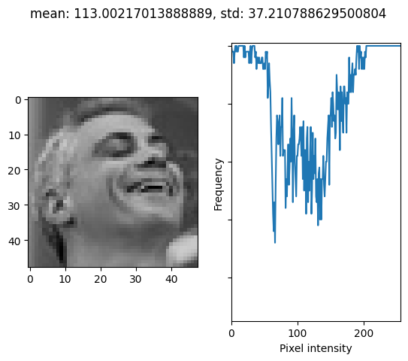
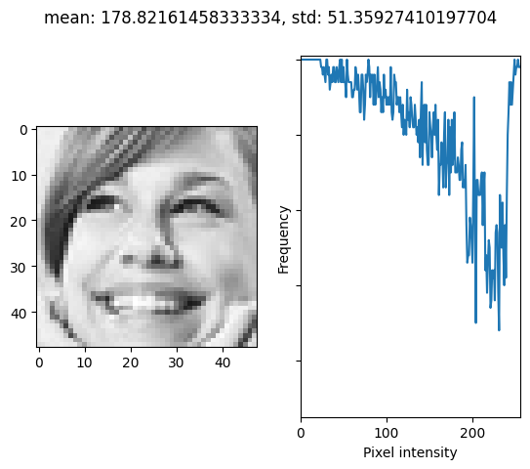
Data Exploration
Key patterns of the facial expressions
Mouthing, Eyebrows, Cheek
Data distribution
Affect the performance of the model
EDA
Image statistics
Notes:
Image statistics is one of the EDA techniques. mean, standard division , histogram will provide information about the characteristics of the data.
You can analyse the image statistics to determine if there are any issues with the data that could affect the performance of the model.
The mean of the image, if the mean is relatively high, indicating that the images may be overexposed or have high brightness levels. It can affect the contrast and make it more difficult for the model to distinguish between different facial features
The standard deviation of the image, if the standard deviation is relatively high, indicating that wide range of pixel value, the image has higher contrast
The pixel intensity shows the contrast and brightness of individual pixel.
8

Slide 9
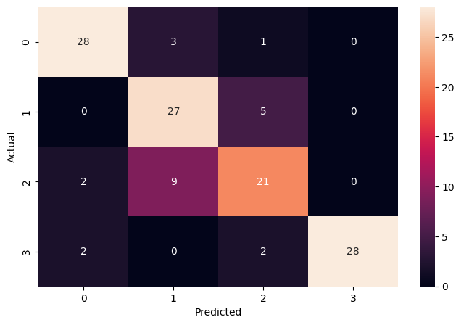
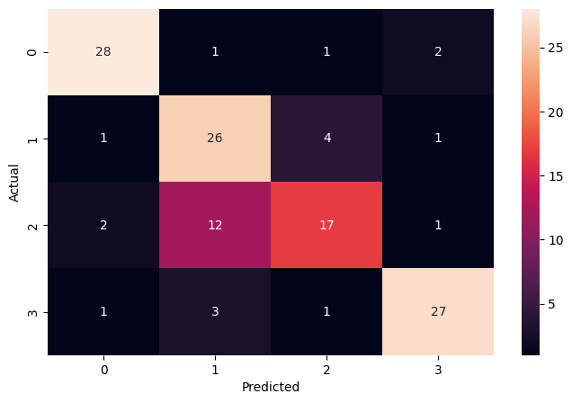
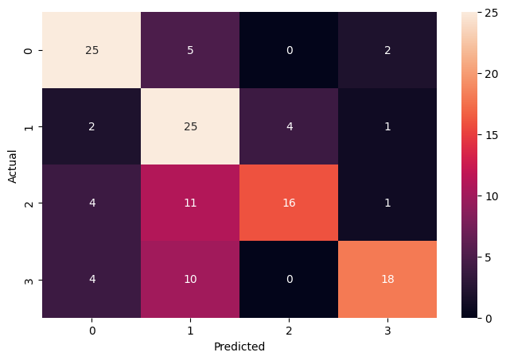
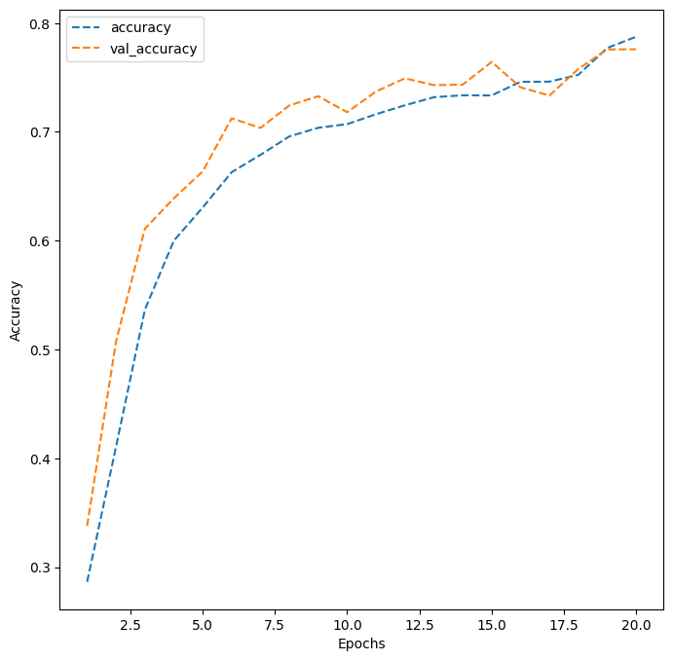
Build Model - Transfer Learning
VGG16, ResNet v2, Efficient Net
VGG16 Accuracy
Training: 78.75%
Validation: 77.6%
Testing: 81%
F1-score: 0.88, 0.76, 0.69, 0.93
ResNet v2 Accuracy
Training: 77.17%
Validation: 76.01%
Testing: 77%
F1-score: 0.88, 0.70, 0.62, 0.86
Efficient Net
Training: 74.71%
Validation: 69.24%
Testing: 66%
F1- score: 0.75, 0.60, 0.62, 0.67
VGG16
ResNet v2
Efficient Net
VGG16 accuracy
Notes:
I tested on different models, for the pre-trained models, VGG16, ResNet v2 and Efficient Net were used.
VGG16, ResNet-v2 and Efficient Net are the famous CNN architectures.
VGG16 is a relatively simple model architecture with 16 weight layers and has been shown to perform well on image classification.
ResNet-v2 is a deeper and more complex model architecture than VGG16, with up to 152 weight layers, a complex CNN architecture that is based on the idea of residual learning.
Efficient Net is a family of model architectures that have achieved state-of-the-art performance on a range of image classification tasks while using fewer parameters and less computation than previous models.
From the above result shows that VGG16 has the best result with learning rate = 0.0005 using Adam optimizer and train in 20 epochs
The detection accuracy rate is over 80%. However, the f1-score of each class is not equal, and classes 0 and 3 can be classified better.
VGG16 simplicity makes it easy to understand and implement.
Both of three models are easy to overfitting when try to increase number of training epochs.

Slide 10
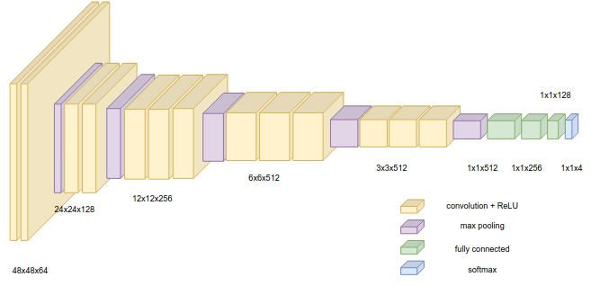
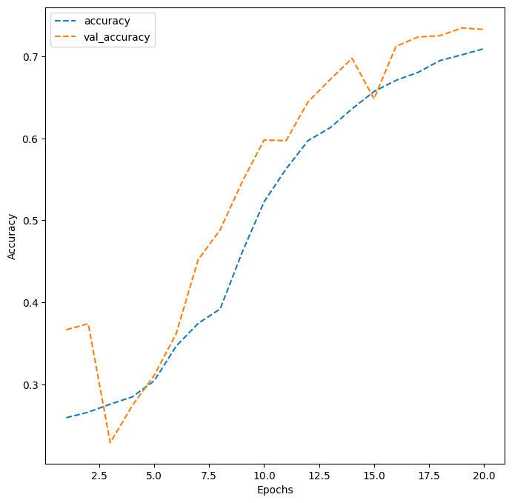
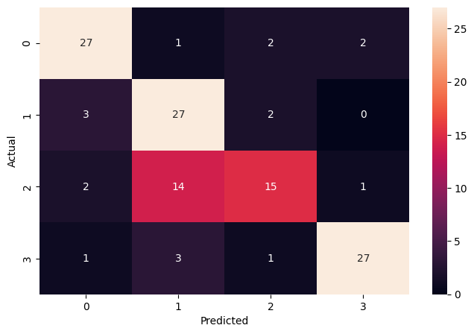
Build Model - Custom built model
5-block CNN Model
Accuracy
Training: 70.93%
Validation: 73.28%
Testing: 75%
F1-score: 0.83, 0.70, 0.58, 0.87
Notes:
We try custom built mode. I try to combine VGG16 architecture with simple input (grayscale).
Train a model with learning rate = 0.0005, use the Adam optimizer and train in 20 epochs
Then we plot the result and found the train accuracy and validation are not overfitting, and the test accuracy can reach 75%

Slide 11
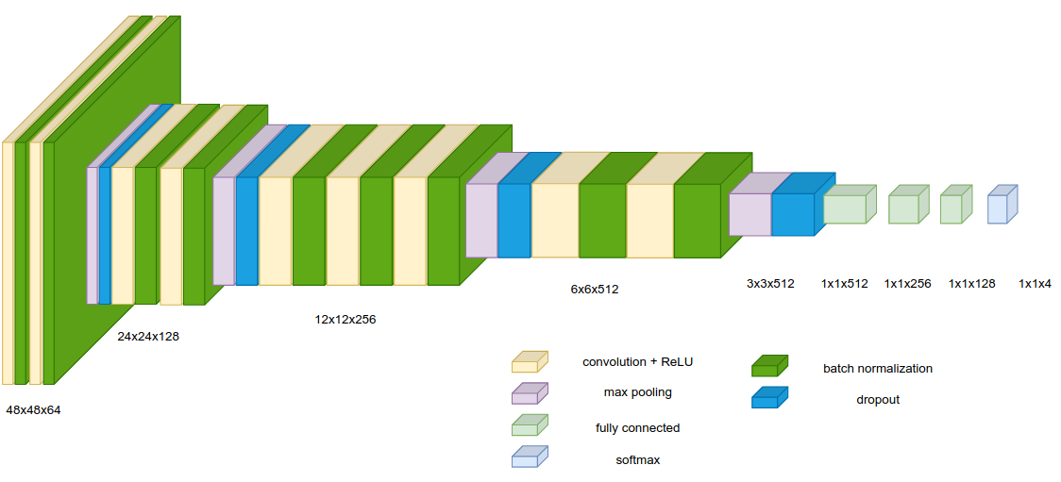
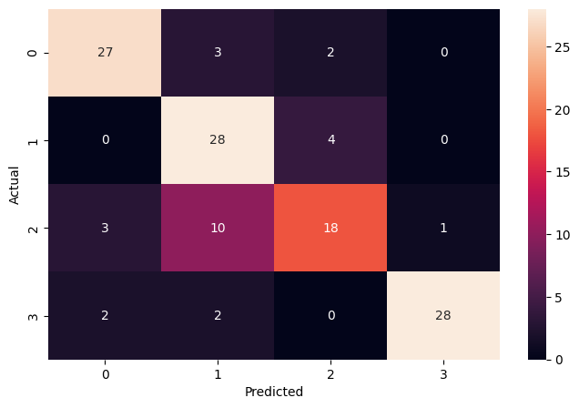
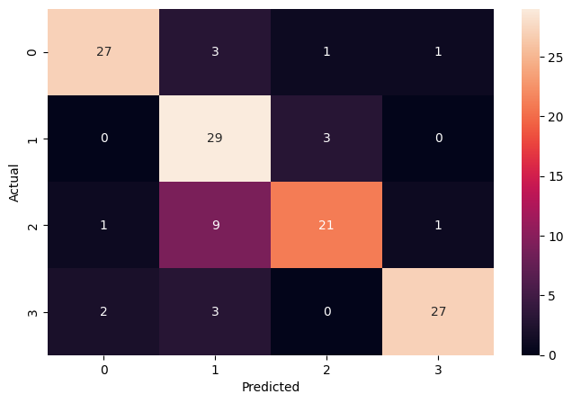
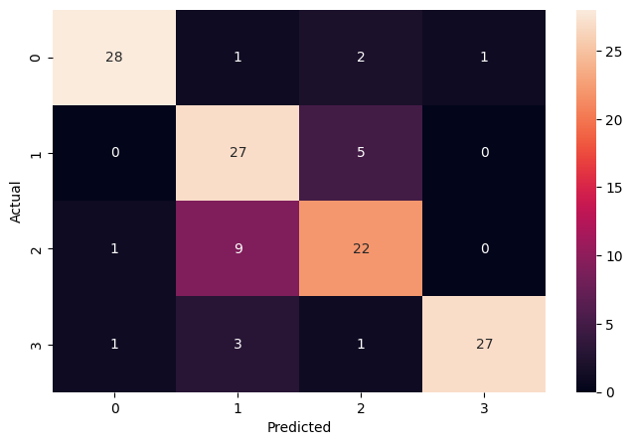
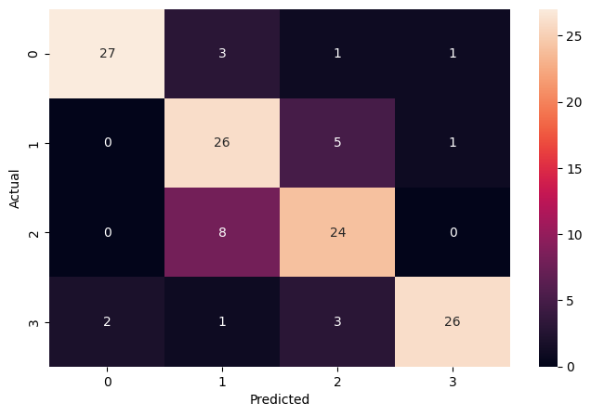
Build Model - Custom built model
4-block CNN Model with batch normailzation and dropout
Accuracy
Without class weight: 79%
F1-score: 0.84, 0.75, 0.64, 0.92
Class 'sad' and 'neutral' weight 3 : 81%
F1-score: 0.87, 0.76, 0.74, 0.89
Class 'sad' and 'neutral' weight 3.5: 81%
F1-score: 0.90, 0.75, 0.71, 0.90
Class 'sad' and 'neutral' weight 4: 80%
F1-score: 0.89, 0.74, 0.74, 0.84
Without class weight
'sad' and 'neutral' weight: 3
'sad' and 'neutral' weight: 3.5
'sad' and 'neutral' weight: 4
Notes:
The model performance can be improve, therefore, I try to modify the CNN architecture and train the model with class weights.
Finally, by tunning learning rate, class weighting, and training epochs, I can achieve a not bad result for sad and neutral class classification.

Slide 12
Summary
On small dataset and domin-specific tasks, pretrained models may perform worse then custom built model
Dropout and batchnormalization can help adjust model overfitting or underfitting
Increasing epochs in custom model can improve accuracy
Training with class weights helps to classify specific classes
Notes:
In summary,
Transfer learning and custom built model can detect the facial emotion but cannot classify some class very well. Such as sad and neutral class.
Beside tunning the learning rate, optimizer and training epochs,
For pre-trained model, we can use fine-tune technique.
For custom built model, we can use class weighting .

Slide 13
PROPOSED Solution
Apply data cleaning
Increase dataset
Ensemble learning
Notes:
Of cause, we have another method help to increase model performance, such as
Increase the size of the dataset. A larger dataset can help the model learn more diverse features
ensemble learning, which combining the predictions of multiple models to improve the overall accuracy.
calculate the entropy of the images, which is a measure of the randomness or complexity of the image, remove unused data in the dataset
Fairness and Bias Mitigation: Facial emotion detection systems can be biased due to factors such as demographic imbalances in the training data or the use of facial features that are more prominent in certain ethnic or racial groups. To address these issues, techniques such as data balancing, feature selection, and adversarial training can be used to improve fairness and mitigate bias in the facial emotion detection system.
Image statistics
Next, you calculate the entropy of the images, which is a measure of the randomness or complexity of the image. You find that the entropy of the images is relatively low, indicating that the images may be too simple or lack diversity in terms of facial expressions, poses, or backgrounds. This can make it more difficult for the model to learn the complex features that are necessary for accurate facial emotion detection.

Slide 14
Future discussion
Real time detection
Application
Notes:
Challenge on real time detection
Customer service
Heathcare
14

Slide 15
Thank You!
Notes:
15

Slide 16
Reference
[1] https://content.time.com/time/business/article/0,8599,1954643,00.html
[2] https://www.kaspersky.com/resource-center/definitions/biometrics
[3] https://www.thalesgroup.com/en/markets/digital-identity-and-security/government/biometrics/facial-recognition
[4] John Chris T. Kwong, Felan Carlo C. Garcia, P. Abu, R. Reyes
Emotion Recognition via Facial Expression: Utilization of Numerous Feature Descriptors in Different Machine Learning Algorithms, 2018

